Slide 1
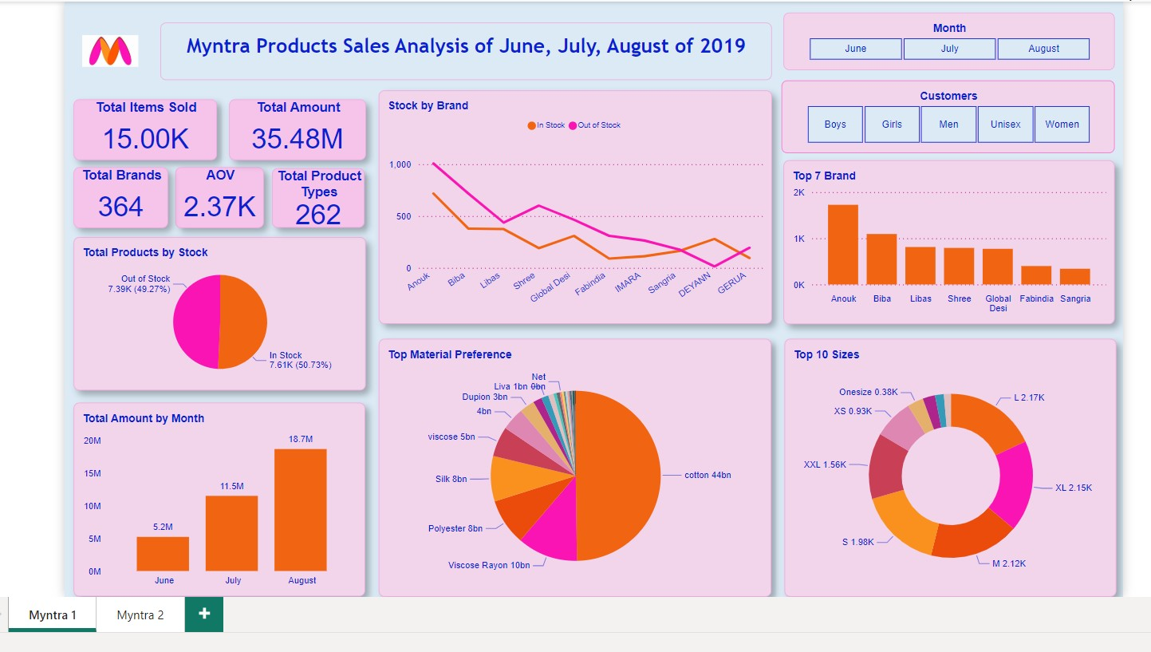

Slide 2
Insight
The total sales revenue across June, July, and August 2019 reached an impressive ₹35.48 million. This indicates a strong performance during the summer months.
Sales revenue exhibited significant growth, rising from ₹5.2 million in June to ₹11.5 million in July, and peaking at ₹18.7 million in August. This upward trend reflects increasing customer demand and effective sales strategies.
A total of 15,000 units were sold over the three-month period, demonstrating robust sales activity.
Among the top seven brands, Anouk achieved the highest sales figures, indicating its strong market presence. However, several brands, including Anouk, Biba, and Libas, experienced high out-of-stock rates.
Alarmingly, 49.27% of products were reported as out of stock during this period. Addressing this issue is critical to maximizing sales potential and meeting customer needs.
The average order value decreased from ₹2,480 in June to ₹2,290 in August, suggesting a need to explore strategies to enhance AOV moving forward.

Slide 3
Insight
The total items sold rate is doubling every month, indicating a positive trend in customer engagement and product demand.
A total of 262 different product types were sold during this period, showcasing a diverse product range that caters to various customer preferences.
Cotton products dominated sales with 44 billion units sold, while materials like Net, Dupion, and Liva showed lower preference among consumers.
The most sold sizes were L (2,170 units) and XL (2,150 units). Notably, men showed a preference for sizes XL, L, and M; women preferred sizes S, L, and M; while unisex customers favored double sizes.
An overwhelming 92% of unisex customers preferred cotton material for their purchases. Brands such as DDecor and Raymond were particularly favored by unisex customers.
August not only saw the highest revenue but also the greatest number of items sold, highlighting its significance in the overall sales performance for the summer season.
Men had the highest average order value at ₹2,750, compared to women at ₹2,170 and unisex customers at ₹2,650, suggesting differing spending behaviors that could inform targeted marketing strategies.

Slide 4
Actionable Strategy
Collaborate closely with suppliers to ensure faster replenishment of popular brands like Anouk and Biba, minimizing stockouts and improving sales opportunities.
Capitalize on the popularity of Anouk and Biba by creating product bundles, offering customers more value while increasing Average Order Value (AOV).

Slide 5
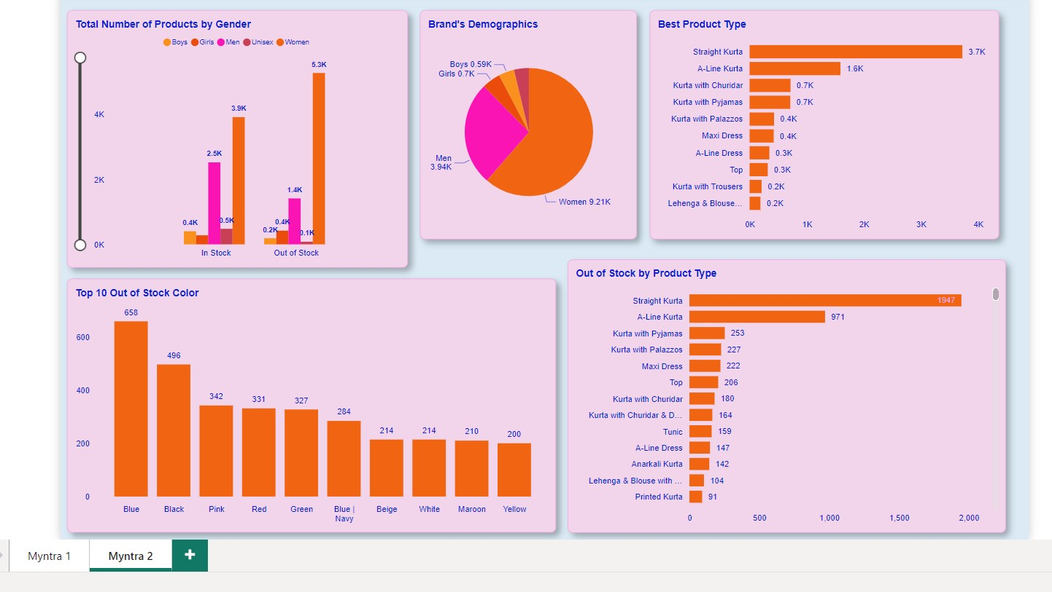

Slide 6
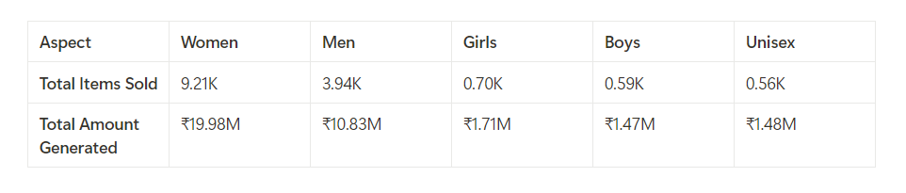
Insight
Women's products dominate the inventory with 9,210 items, while men's products account for 3,940 items. This distribution highlights a strong focus on women's offerings in our product range.
A significant number of products are currently out of stock, particularly in the women's category, which has 5,300 items unavailable, and the men's category, which has 1,400 items out of stock. Addressing these stock shortages is crucial to meeting customer demand and maximizing sales opportunities.
The Straight Kurta is the best-selling product type, with a total of 3,700 units sold. However, it also has the highest out-of-stock rate at 1,947 units, indicating a need for better inventory management to ensure availability.
The color blue is the most frequently out of stock, with 658 units unavailable, followed by black at 496 units. These colors are popular among customers, and maintaining adequate stock levels will help meet consumer preferences.

Slide 7
Insight
The A-Line Kurta ranks as the second best-selling product type with 1,600 units sold, but it also has a high out-of-stock rate of 971 units. This trend suggests that we should prioritize replenishing these popular items to enhance sales.
The men's segment generates a total revenue of ₹10.83 million from 3,940 items, demonstrating a higher revenue per item compared to other segments. This indicates strong demand and potential for further growth in the men's category.
The boys' segment contributes 590 units, while the girls' segment accounts for 700 units sold. Although these figures are minimal compared to other categories, they still represent notable sales that should not be overlooked.
An overwhelming majority of customers (92%) prefer cotton material for their purchases, indicating a strong market preference that should inform future product development and sourcing strategies.

Slide 8
Actionable Strategy
Straight Kurta and A-Line Kurta are our best-selling products and should be prominently featured in upcoming marketing campaigns. By emphasizing these popular items, we can attract more customers and drive higher sales.
Out-of-stock items can lead to customer dissatisfaction and lost sales opportunities. To mitigate this, we should implement a notification system that alerts customers when out-of-stock items become available again. This proactive approach will enhance customer experience and loyalty.
Given the high demand for blue and black products, it is essential to allocate higher stock levels for these colors. Ensuring availability will help us meet customer preferences and reduce the likelihood of stockouts.
The men’s product segment appears to be priced higher or has better margins, contributing to increased earnings per unit. We should analyze this segment further to identify successful pricing strategies that can be applied to other categories, potentially enhancing overall profitability.
To boost sales in the girls’ and boys’ segments, we recommend increasing product visibility through targeted marketing efforts and expanding the product range. By diversifying offerings and promoting them effectively, we can capture a larger share of this market.

